Slide 1
PROVISION OF ICT INFRASTRUCTURE & END USER SUPPORT; MAINTENANCE AND SERVICE DESK SERVICES BRIEFING SESSION 18TH DECEMBER 2020

Slide 2
Presentation Outline
SASSA Overview
Technology Landscape
Projects on the pipeline
Objective of the Bid
Scope of the Bid
Support Services
Maintenance Services
Service Desk Services
Resource Requirements
Solution Pricing
Responding to the Bid
Questions

Slide 3
SASSA OVERVIEW
South African Social Security Agency (SASSA) was established in terms of the South African Social Security Agency Act, 2004 (Act No. 9 of 2004) to administer social assistance in terms of Chapter 3 of the Social Assistance Act, 2004 (Act No. 13 of 2004).
SASSA is mandated to ensure effective and efficient service delivery of high quality with regard to the management and administration of social grants such that the entire payment process and system from application to receipt of social grants by a beneficiary, is done in a manner that is sensitive, caring and restores the dignity of the beneficiaries as well the integrity of the whole system.

Slide 4
SASSA OVERVIEW CONT.
The key functions of SASSA are the administration and payment of social grants and include:
The processing of applications for social grants
Verification and approval of applications
Ongoing entitlement reviews of beneficiaries
Disbursement and payment of grants to eligible beneficiaries
Quality service assurance ensuring compliance with norms and standards and fraud prevention and detection.
SASSA provides the following types of social grants
Old Age;
War Veterans;
Disabled Persons;
Grant-in-Aid;
Child Support;
Foster Care;
Social Relief;
Care Dependency;
As well as the correspondence related to these grants.

Slide 5
SASSA OVERVIEW CONT.
The Agency’s offices are structured as per the table below:
The bidder is to propose how they are going to support the users in the offices and ensure that the SLA is met given the geographic distance of the offices.
Location | Regional Offices | Records Management Centres | District Offices | Local Offices | Total
Head Office, Pretoria | 1 | 0 | 0 | 0 | 1
Eastern Cape | 1 | 1 | 7 | 63 | 72
Free State | 1 | 1 | 5 | 19 | 26
Gauteng | 1 | 1 | 5 | 45 | 52
KwaZulu-Natal | 1 | 1 | 5 | 74 | 81
Limpopo | 1 | 1 | 5 | 45 | 52
Mpumalanga | 1 | 1 | 4 | 42 | 48
North West | 1 | 1 | 4 | 36 | 42
Northern Cape | 1 | 1 | 5 | 46 | 53
Western Cape | 1 | 1 | 5 | 16 | 23
Sub-total | 10 | 9 | 45 | 386 | 450

Slide 6
TECHNOLOGY LANDSCAPE – WAN SETUP

Slide 7
TECHNOLOGY LANDSCAPE – LAN ANDTELEPHONY

Slide 8
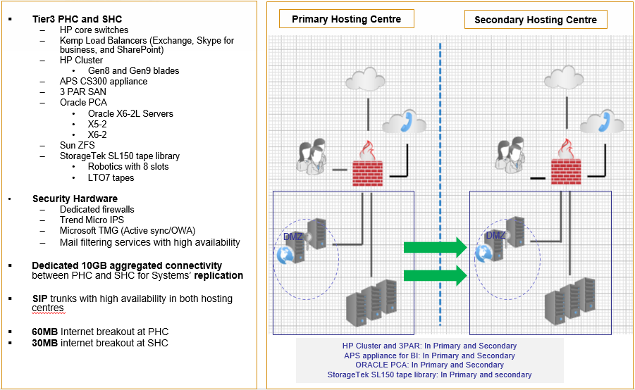
TECHNOLOGY LANDSCAPE – DATA CENTRES

Slide 9
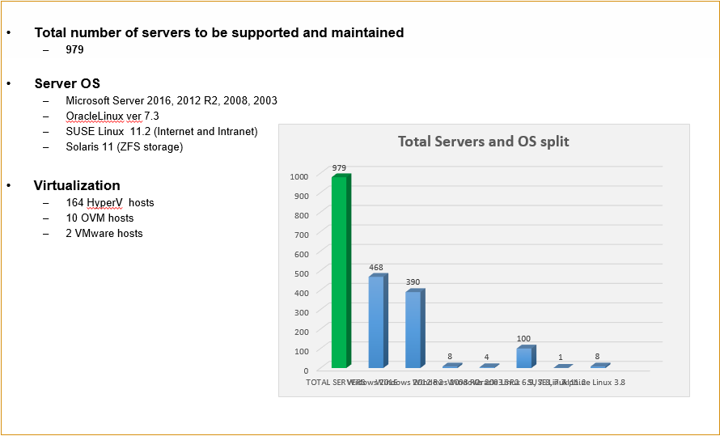
TECHNOLOGY LANDSCAPE – SERVER COUNT

Slide 10
TECHNOLOGY LANDSCAPE – BACK END SERVICES

Slide 11
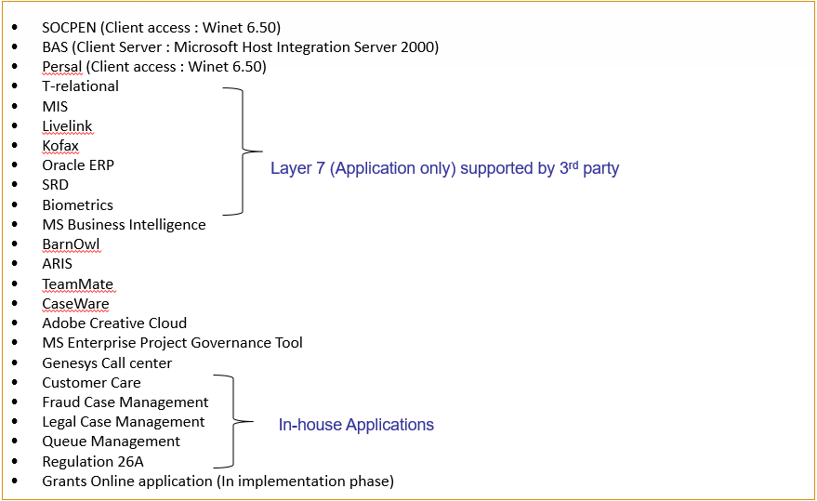
TECHNOLOGY LANDSCAPE – BUSINESS APPLCIATIONS

Slide 12
TECHNOLOGY LANDSCAPE – ICT TOOLS
SCCM 2012
SCOM 2012
Manage Engine
HP IMC TACACS
HP IRS
Rampage TMS 7.0
Oracle Enterprise Manager 13

Slide 13
PROJECTS IN THE PIPELINE
Some of the critical projects currently underway that will be supported by this bid are:
Identity and Access Management (IAM) and Biometric Multifactor Authentication Solution
Online Grants Applications System
Telephony Infrastructure overhaul
UC implementation

Slide 14
OBJECTIVE
The objective of this bid is to:
Invite proposals from prospective bidders with the required expertise and experience to provide for a period of three years (36 months):
ICT Infrastructure & end user Support Services,
Maintenance Services,
Service Desk and
Adhoc Services
Service provision to be aligned to the best practices and standards e.g. ITIL, ISO 20000 etc.

Slide 15
SCOPE OF THE BID
ICT Infrastructure & End User Support Services:
The prospective bidder will act as an extension of the SASSA ICT, it is therefore an objective of SASSA ICT to ensure minimal or no disruption to services
Bidder to ensure that they have a national footprint where emphasis is put on rural roads areas with gravel roads, taking note of the Agency offices as per attachment 2 of this bid
Support at the pay points (noting that this user is attending to more than one pay point a day) i.e. mobile users
Emphasis on loan equipment at the time a call is attended to ensure that the user is operational
Service Desk
The bidder to ensure that calls are logged and managed in one single point, i.e. bidder to propose one system that will also be used by the support team
Maintenance Services
To reduce the number of calls, the bidder is required to conduct proactive preventative maintenance on all technology platform on a monthly basis

Slide 16
SCOPE OF THE BID CONT.
Adhoc Services
The Agency holds Imbizos and executive committee meetings on out-of-office venues from time to time
These require support to ensure minimal impact should there be disruption
In as far as IMACD is concerned Adhoc Services only applies to a project where more than 50 computers are to be setup, deployed and decommissioned within a stipulated timeline as guided by the project plan
Break fix to be done through OEM approved service providers to ensure that OEM approved parts are procured and installed
Management of the service is key:
End to end configuration management is key to the successful delivery of these services
Vendor management is also critical for this bid, i.e. coordination and management of vendor calls to ensure that incidents are resolved as quickly as possible and ensuring that vendor service levels are met

Slide 17
SCOPE OFTHE BID CONT.
In support of the SASSA mandate, ICT must ensure that it:
Enables business to improve turnaround times in social grant application and review processes
Improve productivity of staff
Reduce disruption to business systems/services
The service levels below will not be negotiated down:
1 Hour at Head Office;
1 Hour at Regional Offices;
2 Hours at District Offices; and
2 Hours at Local and Service Points
In cases where a District and or Local Office occupies the same building as the Regional Office, the Regional Office SLA will apply
A List of the Agency’s offices is attached on the bid advert and the bidder is to propose a support structure in line with the attached in support of the above service levels.

Slide 18
RESOURCE REQUIREMENTS
Resource requirements
SASSA requires dedicated resources (no sharing with the bidder’s other clients) with proven track record of the responsibilities they will undertake
The Agency deals with sensitive information of the their clients (beneficiaries), as such all resources will undergo a vetting process before they can be brought on board
The bidder to ensure that they allocate a Service Delivery Manager who will manage and monitor performance of resources

Slide 19
BID PRICING PROPOSAL
Bidders must ensure that pricing is structured as per Annexure D where detailed pricing and summarised prices will be presented
Pricing to be submitted in a separate closed temper proof envelope
NB! The contract must give flexibility to shrink and grow

Slide 20
RESPONDING TO THIS BID
When responding to each of the elements the following is key :
Bidder must clearly indicate :
The resources and skills required to render and manage a particular service
How the service will be rendered e.g. the development of SOPs and reports etc.
Bidder must clearly demonstrate a separation of the responsibly between operations and governance. (e.g. Operational Management will be responsible for backups, and the Governance Management will provide oversight to ensure that there are processes (SOPs), and evidence (POEs) exist to enable the backups, and further report that the backups were successful and further report on any variance.
Most importantly the Configuration Management capability must be aligned and integrated to the operations and the CMDB must maintained

Slide 21
RESPONDING TO THIS BID
The bidder is required to respond using the prescribed annexures
Annexure A – Mandatory Elements
Annexure B – Response Annexure
Annexure C – Track Record
Annexure D – Solution Pricing
Mandatory elements are marked with 3 asterisks (***), and these are compulsory for the bidder to comply with
Failure to comply to ANY of these elements will result in the bid response being disqualified
Avoid using the word but and or however when responding to the mandatory elements as these two words indicate a condition to your response and will be regarded as non compliance

Slide 22
RESPONDING TO THIS BID
Any additional information that the Agency might have omitted and or is necessary for this bid must be referenced clearly for the ease of evaluation
Provide three copies of your proposal, i.e.
2 Hard Copies and
1 Soft Copy (DVD / CD / Memory Stick)
Remember, pricing must be separated even on the soft copy

Slide 23
PREQUALIFICATION
This bid has a pre qualification where prospective bidders are required to sub-contract a minimum of 30% of the total contract value to EMEs or QSEs which are 51% owned by either of the following
These EMEs or QSEs are listed on page 27 of the TOR;
The winning bidder will be required to submit monthly reports and invoices as proof of work done by the sub-contracted EME or QSE and the value thereof, such reports must be co-signed by both the main bidders and sub-contractor;
Your proposal will be invalid, should you not meet the prequalification

Slide 24
Questions..

